Slide 1
Jenkins – Advanced
Priya, Padmapriya & Agila
June 2020

Slide 2
Agenda
Jenkins Integrations
Jenkins integration with SCM tools – GitHub, SVN, Bitbucket, TFS
Jenkins integration with Build tools
Maven
Ant
Gradle
MSBuild
Jenkins integration with Test tools
Junit
NUnit
TestNG
Selenium
SonarQube

Slide 3
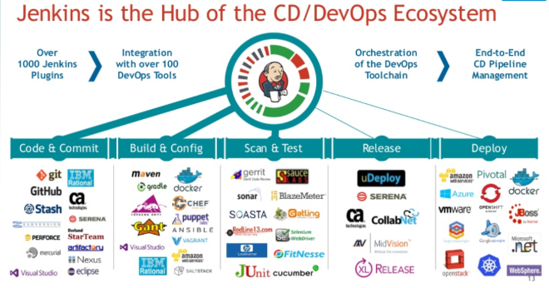
Jenkins Integrations

Slide 4
Jenkins Integration with SCM tools

Slide 5
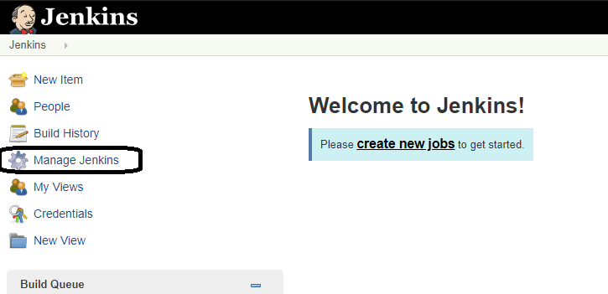
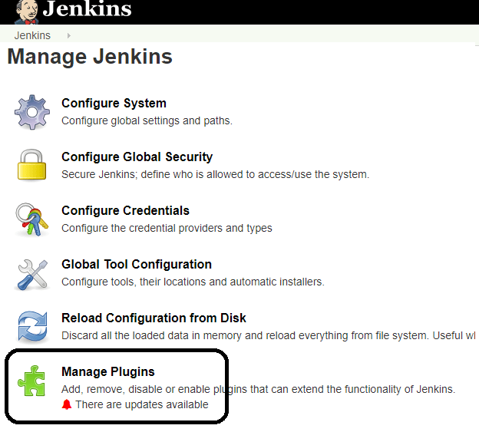
Jenkins – Git Setup
GitHub is a web-based repository of code with SCM features. Jenkins need GitHub plugin to be installed to pull code from GitHub repository.
Step 1: Click on the Manage Jenkins button on your Jenkins dashboard:
Step 2: Click on Manage Plugins:

Slide 6
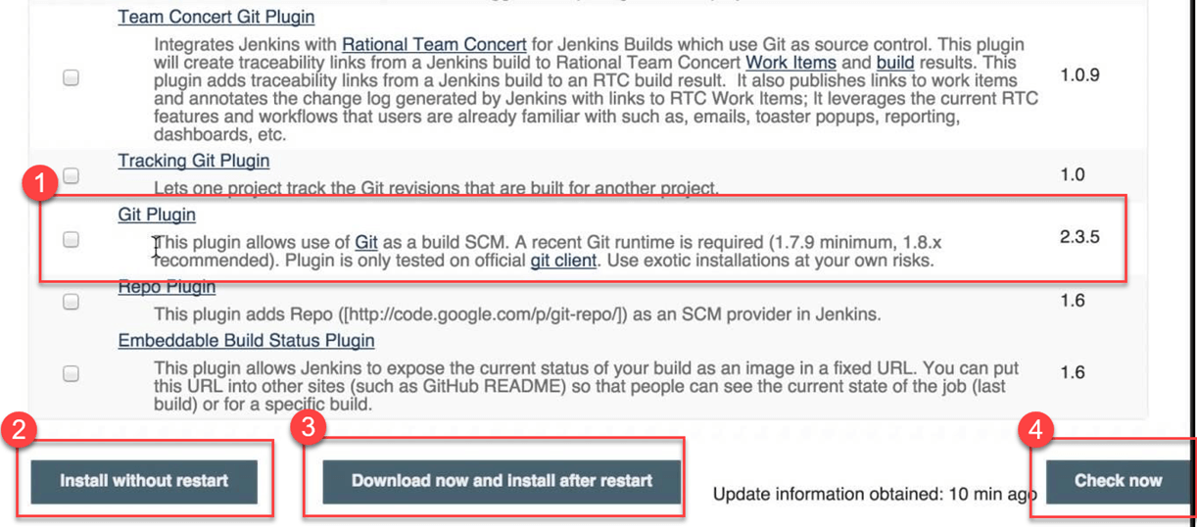
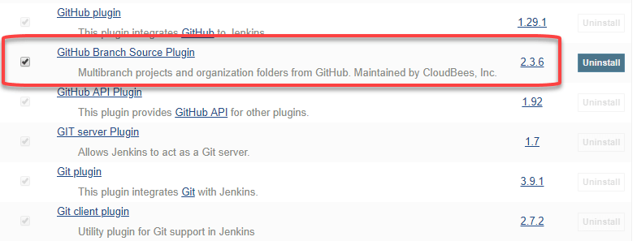
Step 3: In the Plugins Page
Select the GIT Plugin
Click on Install without restart. The plugin will take a few moments to finish downloading depending on your internet connection, and will be installed automatically.
You can also select the option Download now and Install after restart button. In which plugin is installed after restart
You will be shown a "No updates available" message if you already have the Git plugin installed.
Step 4: Once the plugins have been installed, go to Manage Jenkins on your
Jenkins dashboard. You will see your plugins listed among the rest.

Slide 7
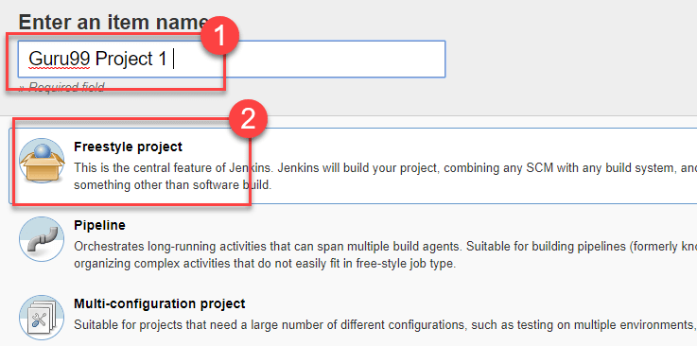
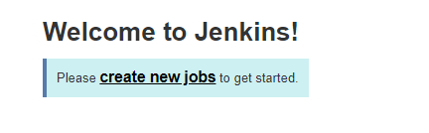
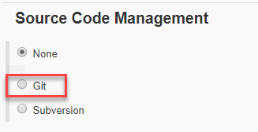
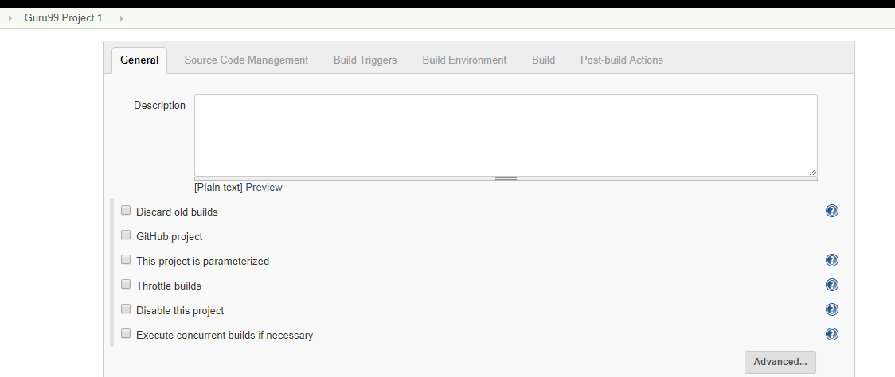
Step 5) Create a new job in Jenkins, open the Jenkins dashboard with your Jenkins URL. For example, http://localhost:8080/
Click on create new jobs:
Step 6) Enter the item name, select job type and click OK. We shall create a Freestyle project as an example.
Step 7) Once you click OK, the page will be redirected to its project form. Here you will need to enter the project information:
Step 8) You will see a Git option under Source Code Management if your Git plugin has been installed in Jenkins:
NOTE: If the Git option does not appear, try re-installing the plugins, followed by a restart and a re-login into your Jenkins dashboard. You will now be able to see the Git option as mentioned above.

Slide 8
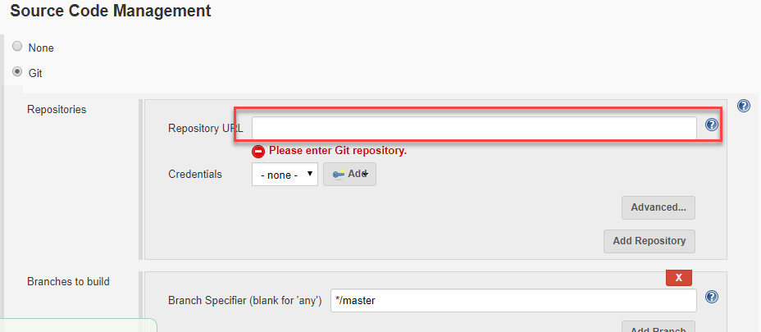
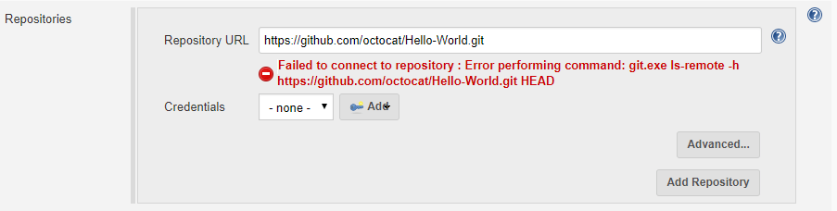
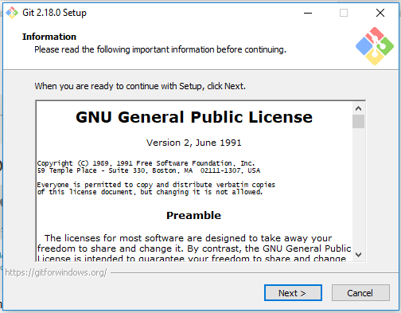
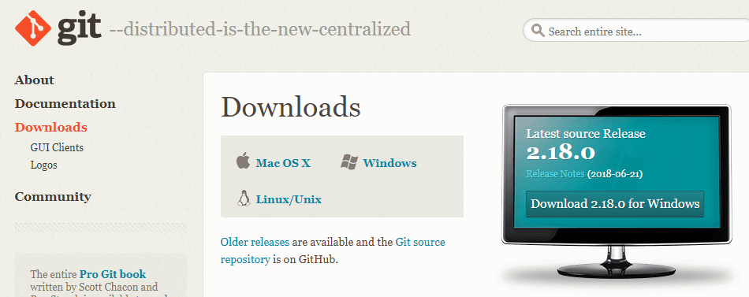
Step 9) Enter the Git repository URL to pull the code from GitHub.
Step 10) You might get an error message the first time you enter the repository URL. For example:
This happens if you do not have Git installed in your local machine. To install Git in your local machine, go to https://git-scm.com/downloads
Download the appropriate Git file for your Operating System, in this case, Windows, and install it onto your local machine running Jenkins. Complete the onscreen instructions to install GIT.

Slide 9
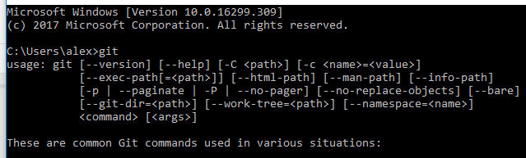
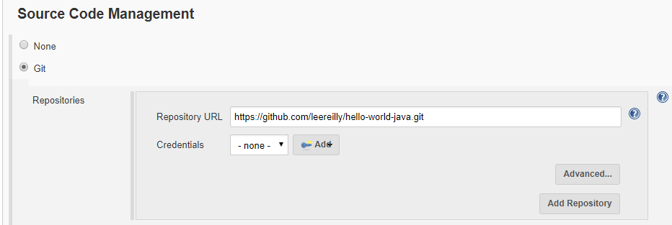
Step 11) You can execute Git repositories in your Jenkins once Git has been installed on your machine. To check if it has been successfully installed onto your system, open your command prompt, type "Git" and press enter. You should see different options come up for Git:
Step 12) Once you have everything in place, try adding the Git URL into Jenkins. You will not see any error messages:
This means that Git has been installed in your system.
Note: If you have GIT already installed in your system, just add git.exe path in Global Tool Configuration.

Slide 10
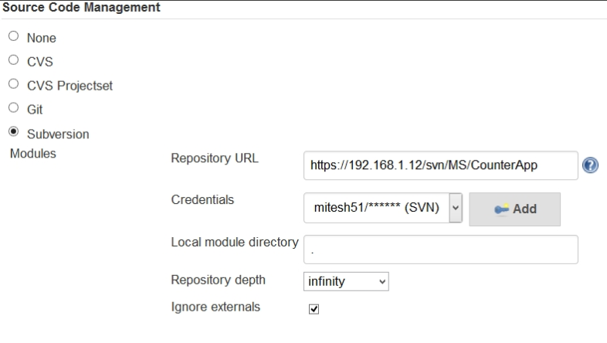
Jenkins with SVN
Install Jenkins Subversion plugin.
Create freestyle project.
Choose Subversion option
In SCM tab.
Enter repository URL.

Slide 11
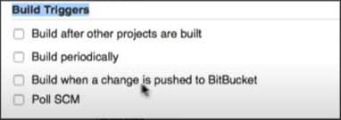
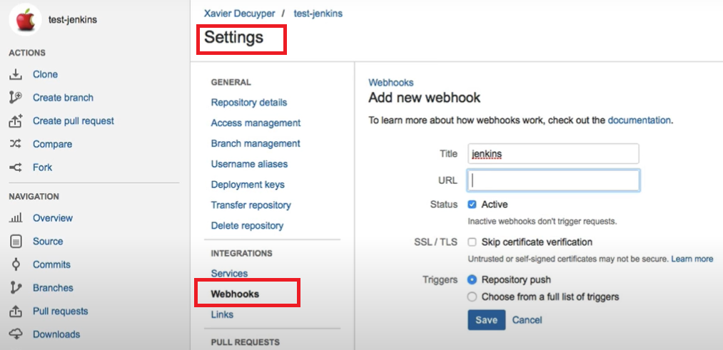
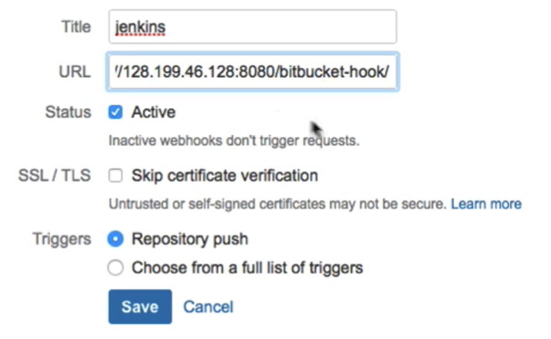
Jenkins with Bitbucket
Install Jenkins Bitbucket plugin.
Create freestyle project.
Choose Git option & provide Bitbucket Repository Clone URL.
Select Build when a change is pushed to Bitbucket option
Create webhook in Bitbucket
Commit the code in Bitbucket & check whether build is
automatically triggered in Jenkins.

Slide 12
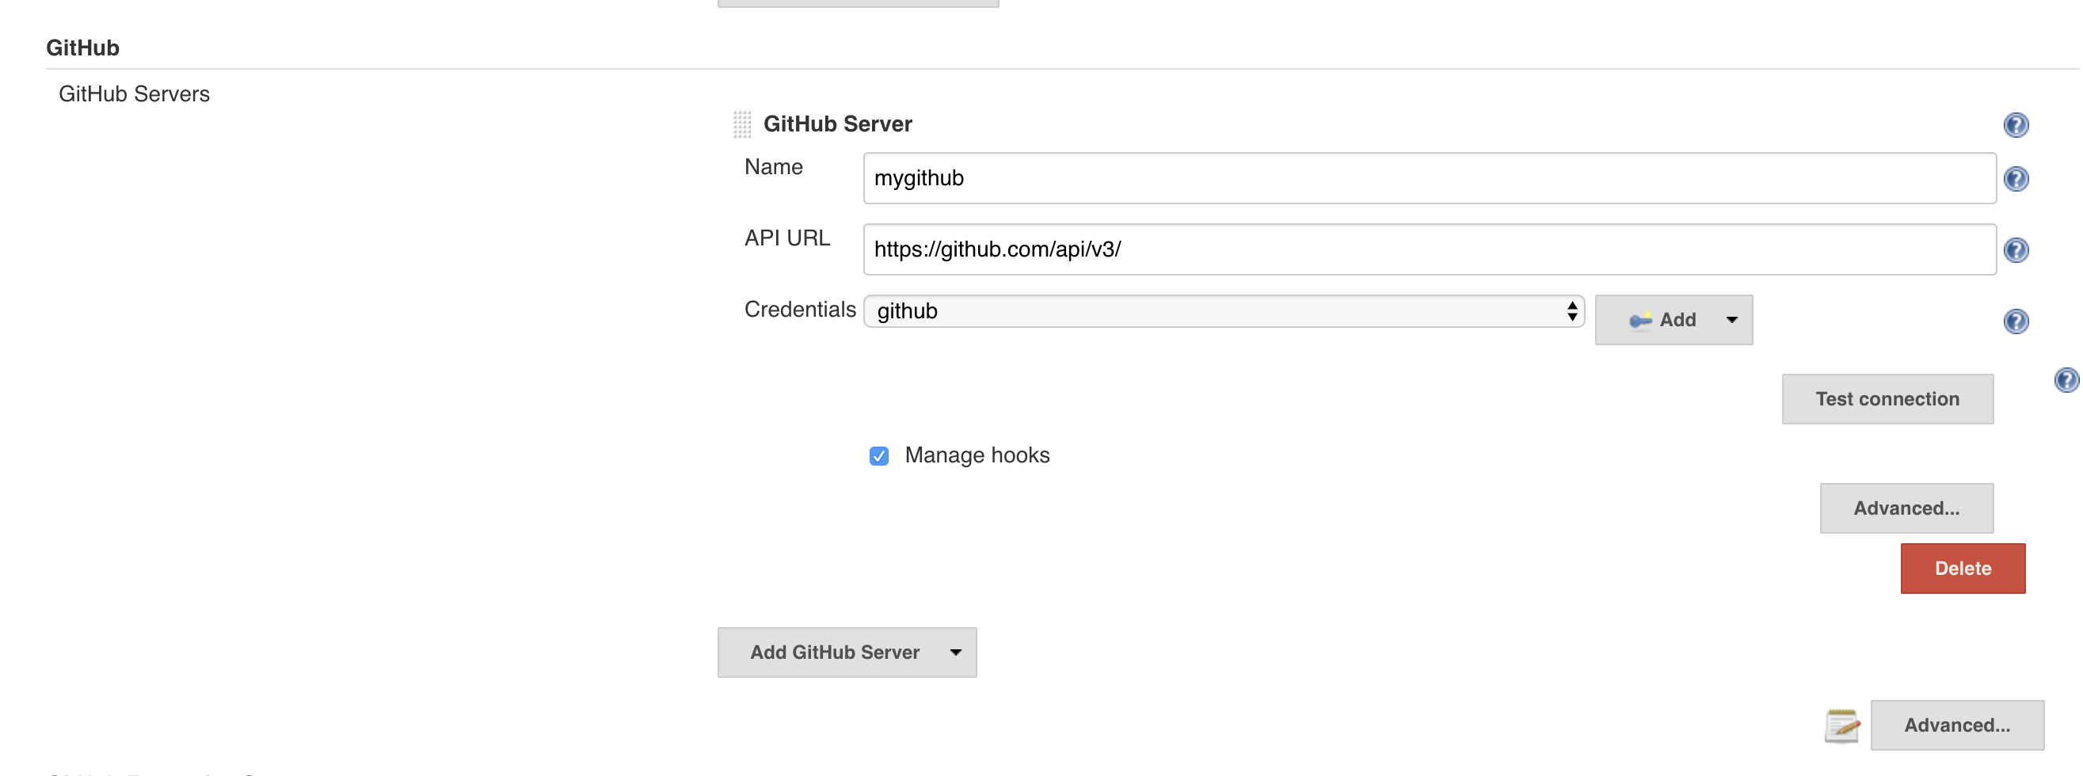
GitHub integration using Webhook - Pipeline
Install Github plugin
Manage Jenkins > Configure system > Add Github instance

Slide 13
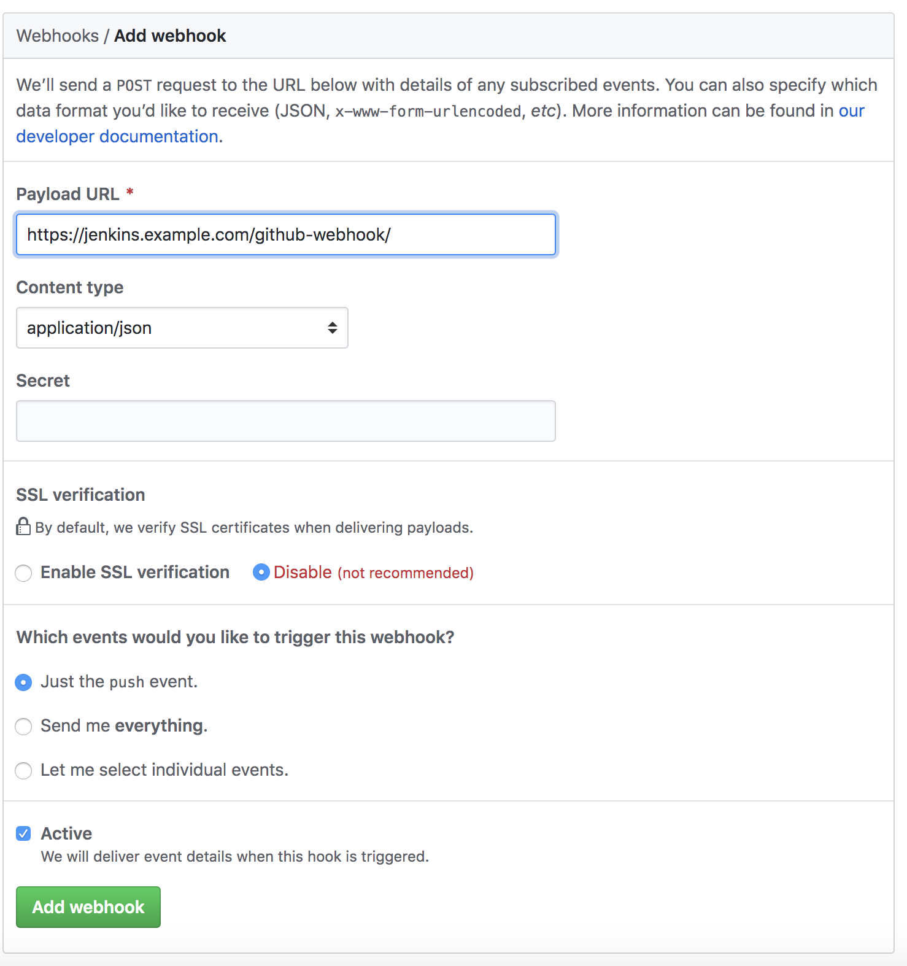
GitHub integration using Webhook - Pipeline
Open Github repository.
Go to “settings” and then to “hooks”.
Click the “Add webhook” button.
Fill in the form, as shown in the image below. For the payload URL, provide your Jenkins URL a
nd the GitHub webhook path at the end of the URL — https://${jenkins_url}/github-webhook/

Slide 14
Git Pipeline
properties([pipelineTriggers([githubPush()])])
stage('Checkout SCM') {
 | steps {
 | checkout([
 | $class: 'GitSCM',
 | branches: [[name: 'master']],
 | userRemoteConfigs: [[
 | url: 'git@github.com:wshihadeh/rabbitmq_client.git',
 | credentialsId: '',
 | ]]
 | ])
 | }
 | }

Slide 15
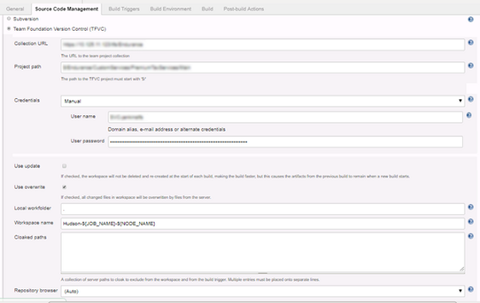
Jenkins with TFS
Install Team Foundation Server Plug-in
Create Freestyle project > Source code management session >
Select option –
“Team Foundation Version Control(TFVC)”
Provide TFS details -
Collection URL:
The URL to the team project collection
Project path:
The path to the TFVC project must start with ‘$/’
Credentials:
Username and password to connect TFS project.

Slide 16
Jenkins Integration with Build tools

Slide 17
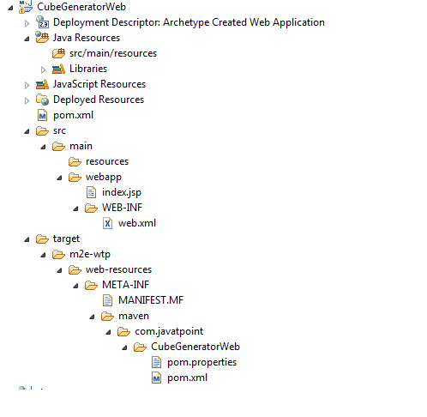
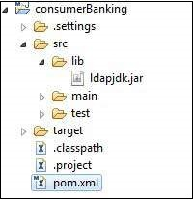
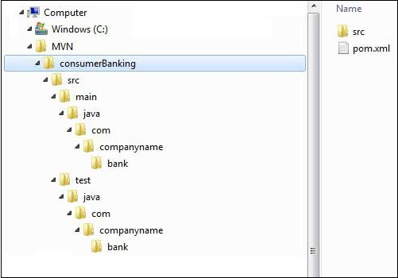
Maven project structures
mvn archetype:generate -DgroupId=com.javatpoint -DartifactId=CubeGeneratorWeb
DarchetypeArtifactId=maven-archetype-webapp -DinteractiveMode=false

Slide 18
Understanding Maven pom.xml (pom - project object model)
It is an XML file that contains information about the project and configuration details used by Maven to build the project.
Element | Description
project | It is the root element of pom.xml file.
modelVersion | It is the sub element of project. It specifies the modelVersion. It should be set to 4.0.0.
groupId | It is the sub element of project. It specifies the id for the project group.
artifactId | It specifies the id for the artifact (project). An artifact is something that is either produced or used by a project. Examples of artifacts produced by Maven for a project include: JARs, source and binary distributions, and WARs.
version | It specifies the version of the artifact under given group.
<project xmlns="http://maven.apache.org/POM/4.0.0"
xmlns:xsi="http://www.w3.org/2001/XMLSchema-instance"
xsi:schemaLocation="http://maven.apache.org/POM/4.0.0
http://maven.apache.org/xsd/maven-4.0.0.xsd">
<modelVersion>4.0.0</modelVersion>
<groupId>com.javatpoint.application1</groupId>
<artifactId>my-app</artifactId>
<version>1</version>
</project>

Slide 19
<project xmlns="http://maven.apache.org/POM/4.0.0"
xmlns:xsi="http://www.w3.org/2001/XMLSchema-instance"
xsi:schemaLocation="http://maven.apache.org/POM/4.0.0
http://maven.apache.org/xsd/maven-4.0.0.xsd">
<modelVersion>4.0.0</modelVersion>
<groupId>com.javatpoint.application1</groupId>
<artifactId>my-application1</artifactId>
<version>1.0</version>
<packaging>jar</packaging>
<name>Maven Quick Start Archetype</name>
<url>http://maven.apache.org</url>
<dependencies>
<dependency>
<groupId>junit</groupId>
<artifactId>junit</artifactId>
<version>4.8.2</version>
<scope>test</scope>
</dependency>
</dependencies>
</project>
Element | Description
packaging | defines packaging type such as jar, war etc.
name | defines name of the maven project.
url | defines url of the project.
dependencies | defines dependencies for this project.
dependency | defines a dependency. It is used inside dependencies.
scope | defines scope for this maven project. It can be compile, provided, runtime, test and system.

Slide 20
A Build Lifecycle is Made Up of Phases
validate - validate the project is correct and all necessary information is available
compile - compile the source code of the project
test - test the compiled source code using a suitable unit testing framework. These tests should not require the code be packaged or deployed
package - take the compiled code and package it in its distributable format, such as a JAR.
verify - run any checks on results of integration tests to ensure quality criteria are met
install - install the package into the local repository, for use as a dependency in other projects locally
deploy - done in the build environment, copies the final package to the remote repository for sharing with other developers and projects.
Command-line maven command
mvn clean package site => Phases
mvn clean:clean => Plugin:Goal
mvn verify
This command executes each default lifecycle phase in order (validate, compile, package, etc.), before executing verify.

Slide 21
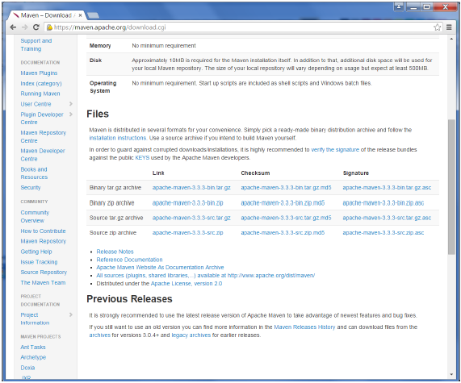
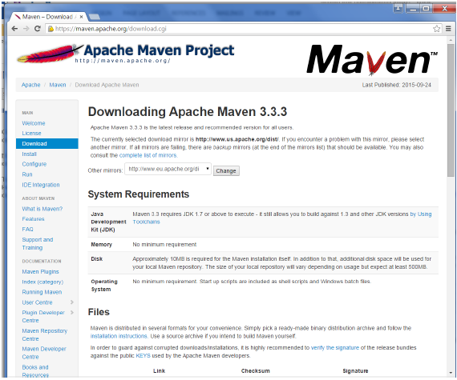
Jenkins – Maven Setup
While browsing to the site, go to the Files section and download the
link to the Binary.zip file.
Maven takes care of build process.
Step 1: Downloading and Setting Up Maven
The official website for maven is Apache Maven. If you click the given link, you can get the home page of the maven official website as shown below.
Once the file is downloaded, extract the files to the relevant application folder.
For this purpose, the maven files will be placed in E:\Apps\apache-maven-3.3.3.

Slide 22
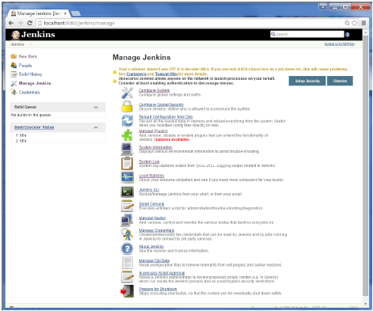
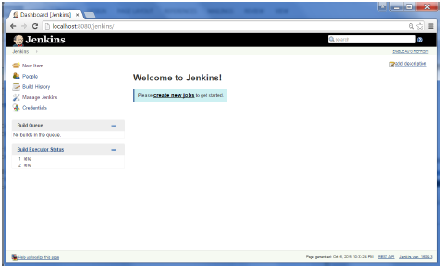
Step 2: Setting up Jenkins and Maven
In the Jenkins dashboard (Home screen), click Manage Jenkins from the left-hand side menu.
Then, click on ‘Configure System’ from the right hand side.

Slide 23
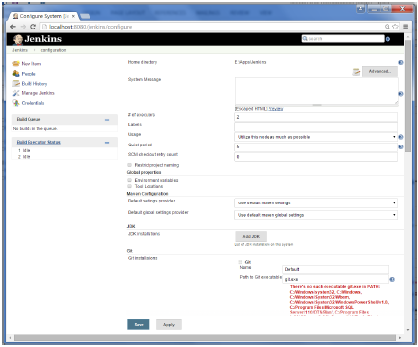
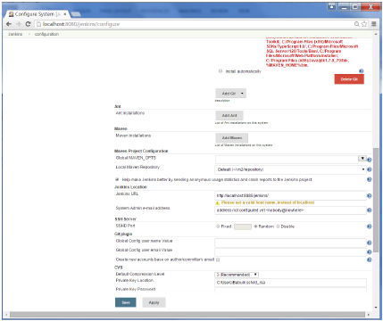
In the Configure system screen, scroll down till you see the Maven section and then click on the ‘Add Maven’ button.

Slide 24
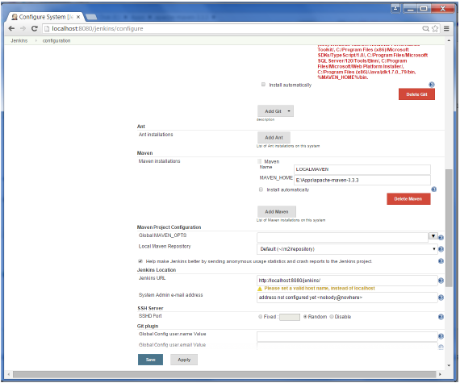
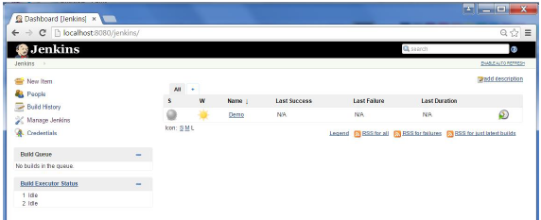
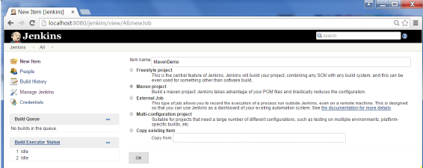
Uncheck the ‘Install automatically’ option.
Add any name for the setting and the location of the MAVEN_HOME.
Then, click on the ‘Save’ button at the end of the screen.
You can now create a job with the ‘Maven project’ option. In the Jenkins dashboard, click the New Item option.

Slide 25
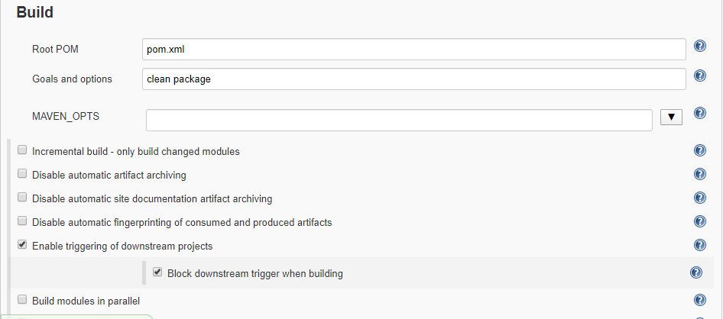
Jenkins Maven Build setting

Slide 26
Jenkins pipeline with Maven code
node {
def mvnHome
stage('Preparation') { // for display purposes
// Get some code from a GitHub repository
git 'https://github.com/jglick/simple-maven-project-with-tests.git'
// Get the Maven tool.
// ** NOTE: This 'M3' Maven tool must be configured
// ** in the global configuration.
mvnHome = tool 'M3'
}
stage('Build') { // Run the maven build
withEnv(["MVN_HOME=$mvnHome"]) {
if (isUnix()) {
sh '"$MVN_HOME/bin/mvn" -Dmaven.test.failure.ignore clean package'
} else {
bat(/"%MVN_HOME%\bin\mvn" -Dmaven.test.failure.ignore clean package/)
}
}
}
stage('Results') {
junit '**/target/surefire-reports/TEST-*.xml'
archiveArtifacts 'target/*.jar'
}
}

Slide 27

ANT Build Overview
Apache Ant is a software tool for automating software build processes which originated from the Apache Tomcat project in early 2000. It was a replacement for the Make build tool of Unix.
Apache Ant is an open-source build tool.
Apache Ant is implemented using the Java language, requires the Java platform, and is best suited to building Java projects. By default, the XML file is named as build.xml .
Ant made it simple to integrate JUnit tests with the build process, Ant made it easy for willing developers to adopt test-driven development, and even extreme programming.

Slide 28
ANT Build Overview
Below is the sample build.xml file for a simple Java "Hello, world" application. It defines four targets -clean, complie, jar and run.
<target name="clean">
<delete dir="${build.dir}"/>
</target>
<target name="compile">
<mkdir dir="${classes.dir}"/>
<javac srcdir="${src.dir}" destdir="${classes.dir}"/>
</target>
<target name="jar" depends="compile">
<mkdir dir="${jar.dir}"/>
<jar destfile="${jar.dir}/${ant.project.name}.jar" basedir="${classes.dir}">
<manifest>
<attribute name="Main-Class" value="${main-class}"/>
</manifest>
</jar>
</target>
<target name="run" depends="jar">
<java jar="${jar.dir}/${ant.project.name}.jar" fork="true"/>
</target>

Slide 29
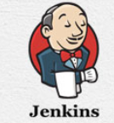
Jenkins - ANT Build Freestyle Project
Steps to do ANT build in a Freestyle Project
Open Jenkins Dashboard.
Click on New Item.
Enter an item name
Select a template – Freestyle project
Click on ok
Go to the source code Management section and select Git.
Provide the Repository URL.
In the Build Section, click on the Add build step and select Invoke Ant

Slide 30
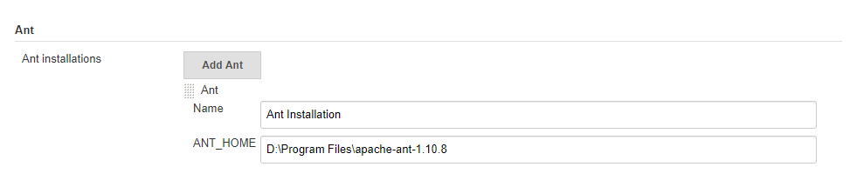
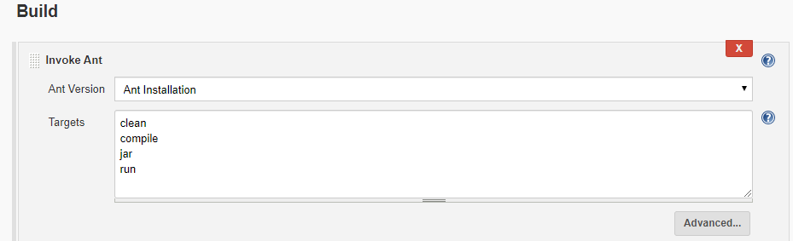
Jenkins - ANT Build Freestyle Project (contd.)
Steps to do ANT build in a Freestyle Project
Select Ant name based on our Global Tool Configuration
Provide Targets, based on the targets defined in build.xml file.

Slide 31
Jenkins - ANT Build Pipeline Project
Steps to do ANT build in a Pipeline Project
Click New Item on your Jenkins home page, enter a name for your (pipeline) job, select Pipeline, and click OK.
In the Script text area of the configuration screen, enter your pipeline syntax. If you are new to pipeline creation, you might want to start by opening Snippet Generator and selecting the “Hello Word” snippet.
Pipelines are written as Groovy scripts that tell Jenkins what to do when they are run. You do not need deep expertise in Groovy to create them, although basic understanding of Groovy is helpful.

Slide 32
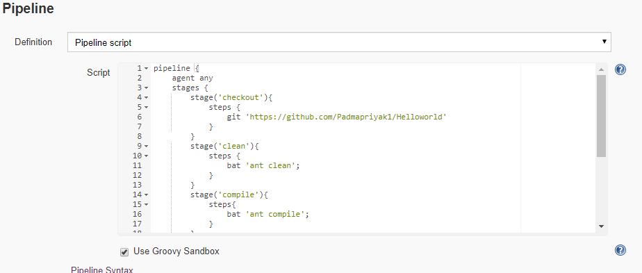
Jenkins - ANT Build Pipeline Project (contd.)
Steps to do ANT build in a Pipeline Project
Pipelines are written as Groovy scripts that tell Jenkins what to do when they are run. You do not need deep expertise in Groovy to create them, although basic understanding of Groovy is helpful.

Slide 33
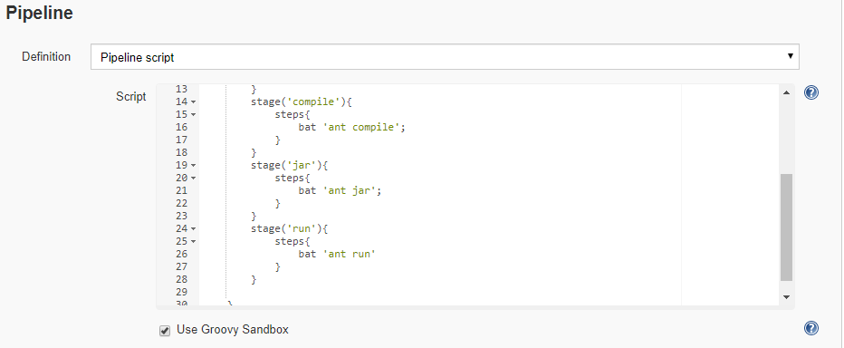
Jenkins - ANT Build Pipeline Project (contd.)
Steps to do ANT build in a Pipeline Project
Check the Use Groovy Sandbox option below the Script text area.
Click Save.
Click Build Now to create the pipeline, select Console Output to see the output.

Slide 34
Jenkins for PHP project using Ant
https://github.com/sebastianbergmann/money/blob/master/build.xml

Slide 35

Gradle Overview
Gradle is an open-source build automation tool focused on flexibility and performance. Gradle build scripts are written using a Groovy or Kotlin DSL.
Highly customizable — Gradle is modeled in a way that is customizable and extensible in the most fundamental ways.
Fast — Gradle completes tasks quickly by reusing outputs from previous executions, processing only inputs that changed, and executing tasks in parallel.
Powerful — Gradle is the official build tool for Android, and comes with support for many popular languages and technologies.

Slide 36
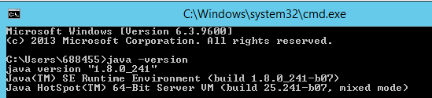
Gradle Installation
Pre-Requisites:
Gradle runs on all major operating systems and requires only a Java Development Kit version 8 or higher to run.
To check, run java –version in command prompt.
Gradle ships with its own Groovy library, therefore Groovy does not need to be installed. Any existing Groovy installation is ignored by Gradle.
Steps:
Download the latest Gradle distribution from the below link:
https://gradle.org/releases/

Slide 37
Gradle Installation
2. Unpack the distribution
Create a new directory C:\Gradle with File Explorer.
Open a second File Explorer window and go to the directory where the Gradle distribution was downloaded. Double-click the ZIP archive to expose the content. Drag the content folder gradle-6.5 to your newly created C:\Gradle folder.
3. Configure your system environment
In File Explorer right-click on the This PC (or Computer) icon, then click Properties → Advanced System Settings → Environmental Variables.
Under System Variables select Path, then click Edit. Add an entry for C:\Gradle\gradle-6.5\bin. Click OK to save.
Alternatively, you could also add the environment variable GRADLE_HOME and point this to the unzipped distribution. Instead of adding a specific version of Gradle to your Path, you can add %GRADLE_HOME%/bin to your Path. When upgrading to a different version of Gradle, just change the GRADLE_HOME environment variable.

Slide 38
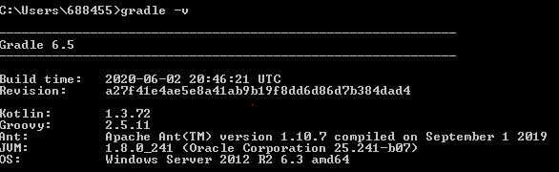
Gradle Installation
Verifying Installation
Open a console (or a Windows command prompt) and run gradle -v to run gradle and display the version, e.g.:

Slide 39
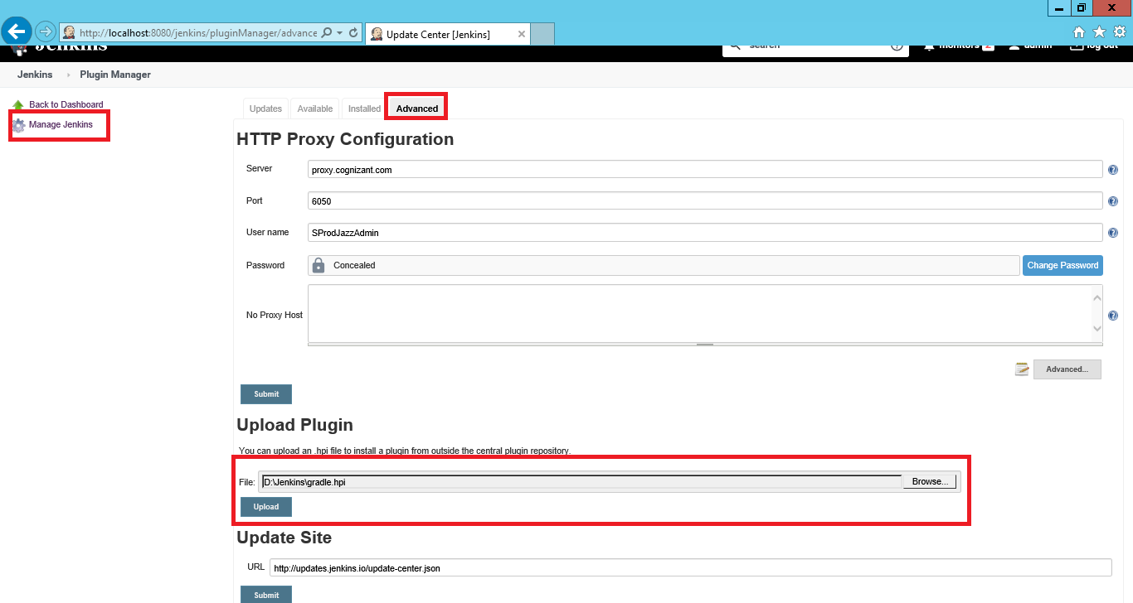
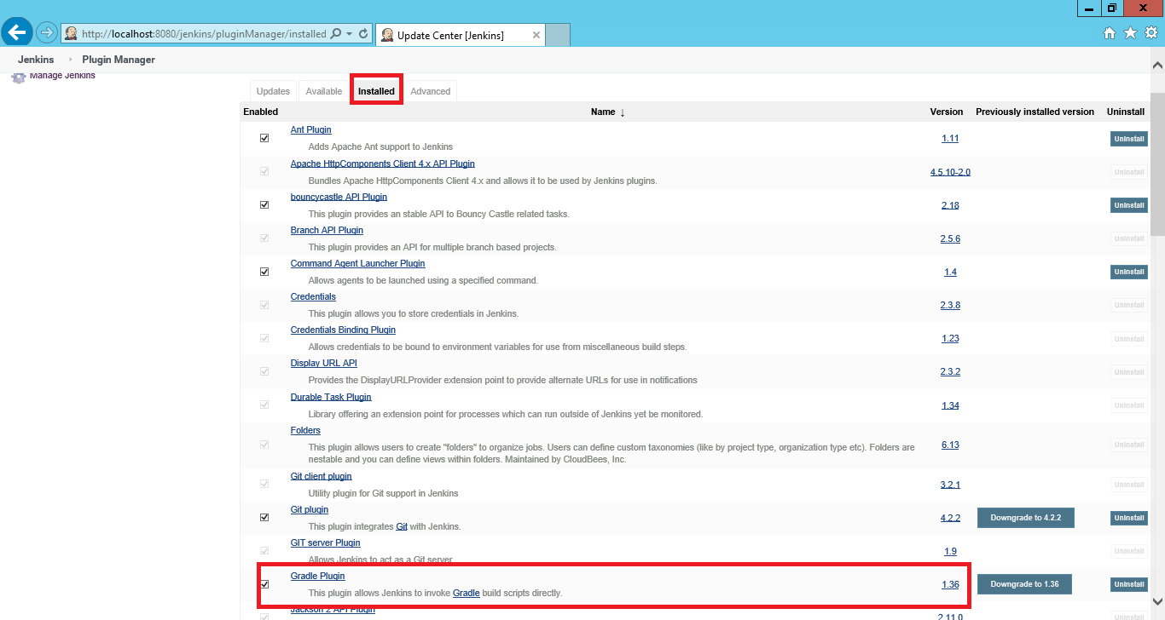
Gradle Plugin Installation in Jenkins
Login to your Jenkins instance and go to Manage Jenkins
Click on Manage Plugins and go to Advanced tab
Go to the Upload Plugin section
Browse the path where Gradle.hpi file you have downloaded and click Upload button
Gradle plugin is installed in Jenkins and it can be viewed in Installed tab of Manage Jenkins page

Slide 40
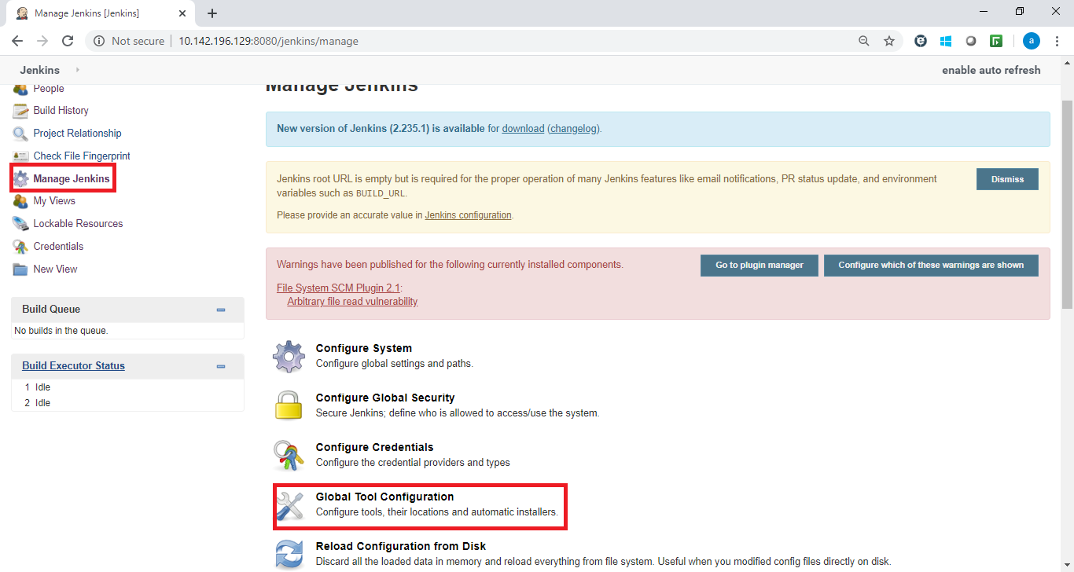
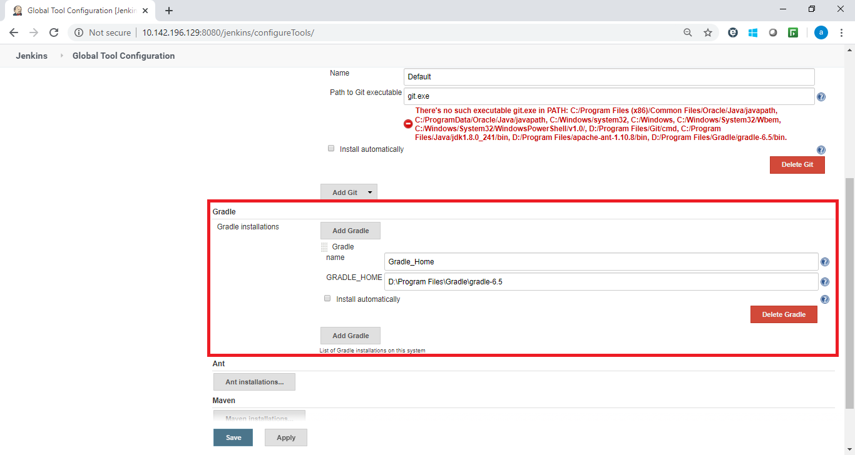
Gradle Plugin Installation in Jenkins
6. Go to Manage Jenkins and click on Global Tool Configuration
7. Add Gradle_Home by providing Gradle Installation path

Slide 41
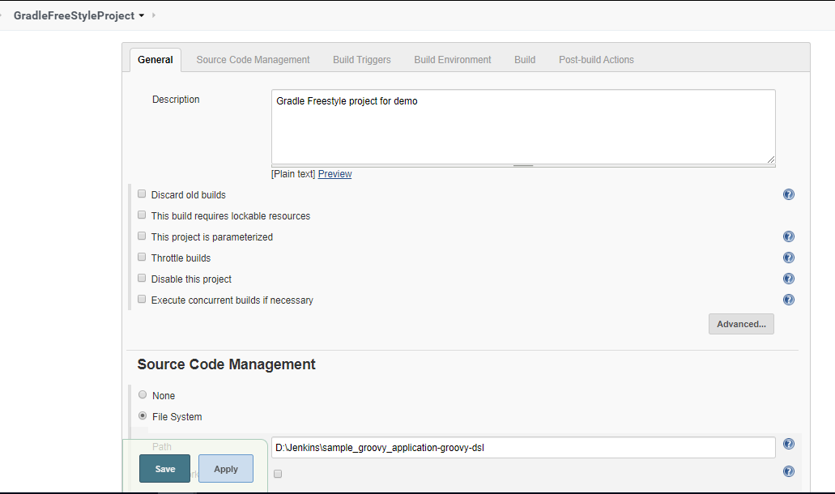
Gradle FreeStyle Project
1. Create Gradle FreeStyle Project by providing its Name and Description
2. Provide the source code path in the Source Code Management Section
3. In the Build section, choose Invoke Gradle option and select Gradle version as Gradle_Home

Slide 42
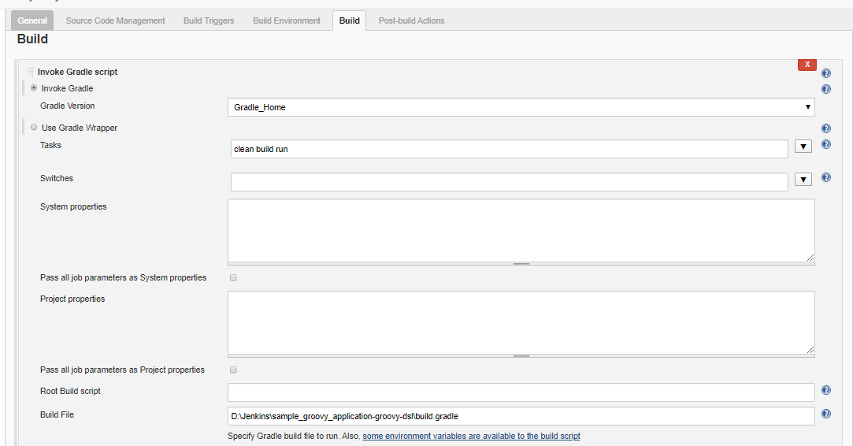
Gradle FreeStyle Project
4. Provide Tasks as ‘clean build’ which will clean the existing build of the application and then build & run the application.
5. Mention the path of the build file and save the project.
6. When you click the build now option, tasks will which we configured will get executed

Slide 43
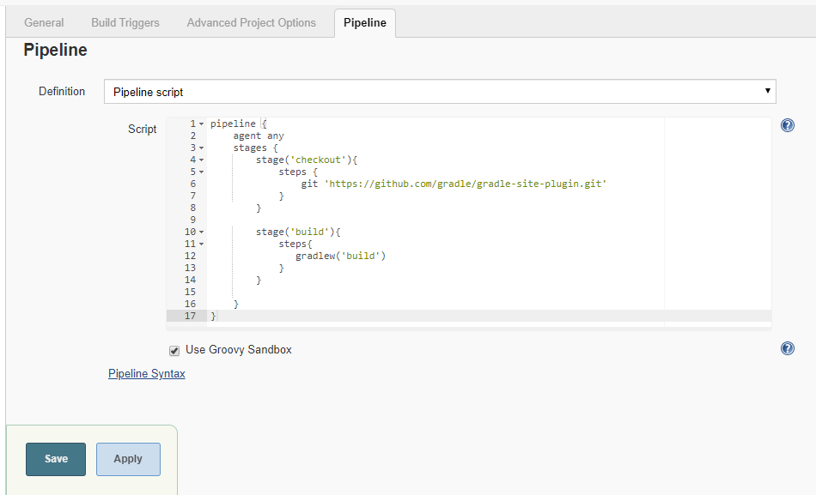
Gradle Pipeline Project
1. Create Gradle Pipeline Project by providing its Name and Description
2. Create Pipeline script in Pipeline Section
3. Save the project
4. Click on Build Now option, pipeline project will get executed and project build will be created.

Slide 44
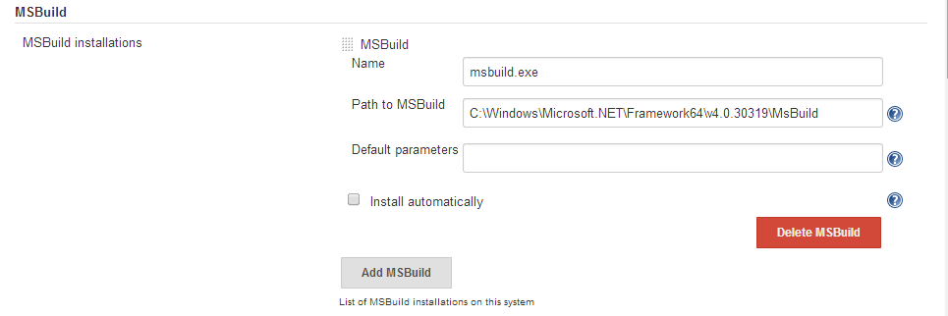
Jenkins integration with MSBuild & NuGet
Install MSBuild Jenkins plugin. This plugin makes it possible to build a Visual Studio project (.proj) and solution files (.sln).
Manage Jenkins > Configure System
Under the MSBuild section, click MSBuild Installations… button
Enter Name- msbuild.exe
Enter default path to msbuild.exe - C:\Windows\Microsoft.NET\Framework64\v4.0.30319\MsBuild

Slide 45

Open the configure page of your Jenkins job
Click Add build step button
Select Build a Visual Studio project or solution using MSBuild
For MSBuild Version, choose the configuration that you have created – msbuild.exe
For MSBuild Build File – enter the path to the project/solution that needs to be built in the format -
${WORKSPACE}\PhantomTube\PhantomTube.sln (${WORKSPACE} is a Jenkins variable that contains the default workspace location)
In Command Line Arguments – you can enter msbuild.exe arguments that you use when you build your project though command line.
For example /p:Configuration=Release is going to build your project in Release mode. Or you can increase the logging verbosity, etc.

Slide 46

Configure NuGet Package Restoration
Download NuGet.exe
Windows batch command :
C:\J\Nuget\NuGet_2.81.exe restore “C:\J\jobs\PhantomTube\workspace\PhantomTube\PhantomTube.sln”

Slide 47
Other Alternatives

Slide 48

G2 Crowd Grid of the mid-market CI tools
Leaders - CircleCI
High performers - Jenkins & Travis CI
Niche - CodeShip, TeamCity, Bamboo and Chef
Contenders - TFS

Slide 49

Table of Comparison

Slide 50

Table of Comparison

Slide 51
Reference

Slide 52
Online Video tutorial
https://www.youtube.com/watch?v=FX322RVNGj4
https://www.youtube.com/watch?v=Lxd6JMMxuwo
Jenkins User Documentation
https://www.jenkins.io/doc/
Jenkins Handbooks
https://www.jenkins.io/doc/book/
https://www.jenkins.io/user-handbook.pdf
Jenkins Vs Other Tools
https://www.altexsoft.com/blog/engineering/comparison-of-most-popular-continuous-integration-tools-jenkins-teamcity-bamboo-travis-ci-and-more/
Jenkins on Cloud
https://geekflare.com/jenkins-hosting-platform/
`

Slide 53
Thank You
Engineering Excellence Team

